Slide 1

Machine Learning-Based Model to Predict the Disease Severity and Outcome in Covid-19 Patients

Slide 2

Agenda
Introduction
Problem Statement
Literature Survey
Objective
Motivation

Slide 3
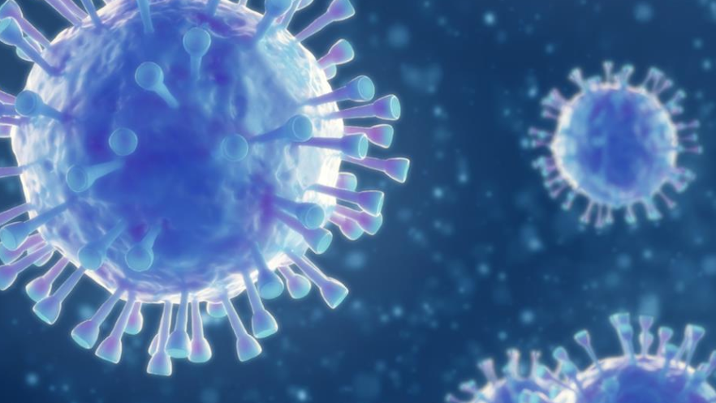
Introduction
Coronaviruses are a large family of viruses that are known to cause illness ranging from the common cold to more severe diseases such as Middle East Respiratory Syndrome (MERS) and Severe Acute Respiratory Syndrome (SARS). A novel coronavirus (COVID-19) was identified in 2019 in Wuhan, China.

Slide 4
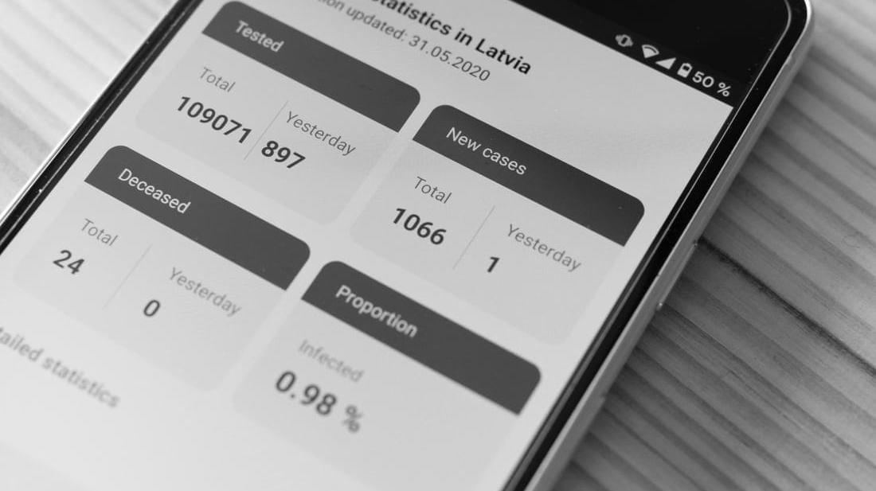
Problem Statement
Its 25th March Afternoon and India has reported its 9th death with 562 total confirmed cases due to COVID-19. Fresh cases from Manipur, Bihar, Gujrat, and Madhya Pradesh have been reported by the Union Ministry of Health and Family Welfare . As the coronavirus outbreak continues to spread in the country, the question that we as Indians are trying to answer is:
"Will India be able to tackle this pandemic or are we going to witness another Italy/ S.Korea/ Wuhan?"

Slide 5
Literature Survey
Authors | Journal | Outbreak Infection | Machine Learning
Ruirui Liang | Transboundary and Emerging Diseases | Swine fever | Random Forest
R Gupta | Infection Disease Modelling | Dengue | Classification & Regression tree (CART)

Slide 6

Objective of the Research
We need a strong model that predicts how the virus could spread across different countries and regions. The goal of this task is to build a model that predicts the spread of the virus in the next 7 days.

Slide 7

Tasks to be Performed
Analysing the present condition in India
Is this trend similar to Italy/S. Korea/ Wuhan
Exploring the world wide data
Forecasting the world wide COVID-19 cases using Prophet

Slide 8

Motivation

Slide 9


Slide 10


Slide 11

Related Work
We will analyse the outbreak of coronavirus across various regions, visualize them using charts and graphs and predict the number of upcoming cases for the next 10 days using Linear Regression and SVM model in Python.

Slide 12
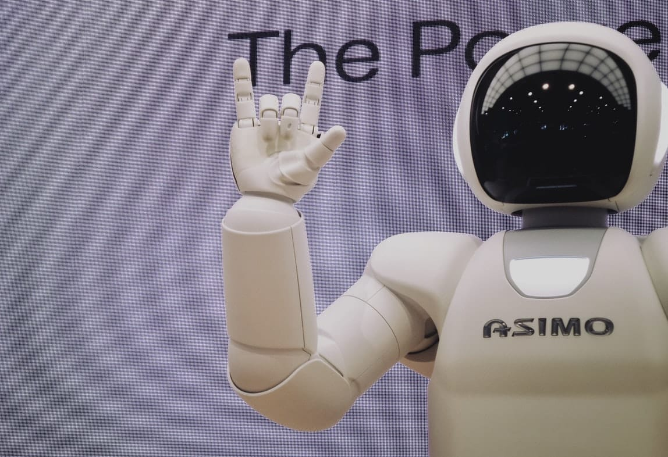
Conclusion
COVID-19 is still an unclear infectious disease, which means we can only obtain an accurate SEIR prediction after the outbreak ends. The outbreak spreads are largely influenced by each country’s policy and social responsibility. As data transparency is crucial inside the government, it is also our responsibility not to spread unverified news and to remain calm in this situation.
The Machine Learning-Based Model to Predict the Disease Severity and Outcome in Covid-19 Patients project has shown the importance of information dissemination that can help in improving response time, and help planning in advance to help reduce risk. Further studies need to be done to help contain the outbreak as soon as possible.

Slide 13

Thank You
Presented By Ayana Rukasar

